Slide 1

Chapter 15
Wireless LANs
Copyright © The McGraw-Hill Companies, Inc. Permission required for reproduction or display.
Notes:
1

Slide 2
Chapter6: Outline
15.1 INTRODUCTION
15.2 IEEE 802.11 PROJECT
15.3 BLUETOOTH
Notes:
15.#

Slide 3

Chapter 15: Objective
The first section introduces the general issues behind wireless LANs and compares wired and wireless networks. The section describes the characteristics of the wireless networks and the way access is controlled in these types of networks.
The second section discusses a wireless LAN defined by the IEEE 802.11 Project. This section defines the architecture of this type of LAN and describes the MAC sublayer.
The third section discusses the Bluetooth technology as a personal area network (PAN). The section describes the architecture of the network, the addressing mechanism, and the packet format. Different layers used in this protocol are also briefly described and compared with the ones in the other wired and wireless LANs.
Notes:
15.#

Slide 4
15-1 INTRODUCTION
Wireless communication is one of the fastest-growing technologies. The demand for connecting devices without the use of cables is increasing everywhere. Wireless LANs can be found on college campuses, in office buildings, and in many public areas. Before we discuss a specific protocol related to wireless LANs, let us talk about them in general.
15.4
Notes:
15.#

Slide 5
15.15.1 Architectural Comparison
Let us first compare the architecture of wired and wireless LANs to give some idea of what we need to look for when we study wireless LANs.
15.5
Notes:
15.#

Slide 6
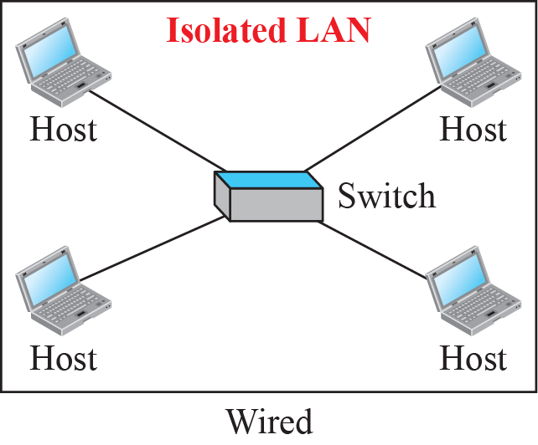
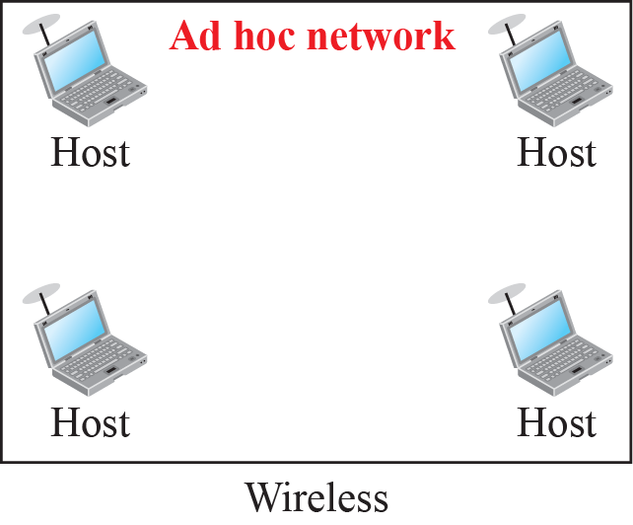
Figure 15.1: Isolated LANs: wired versus wireless
15.6
Notes:
15.#

Slide 7
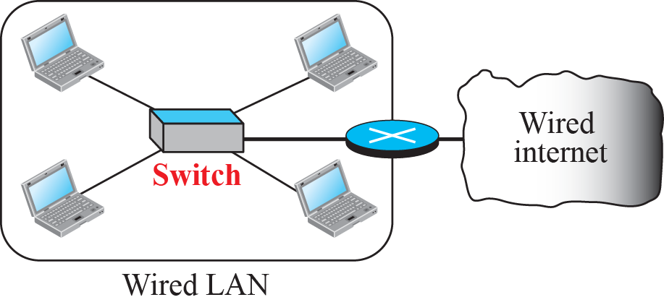
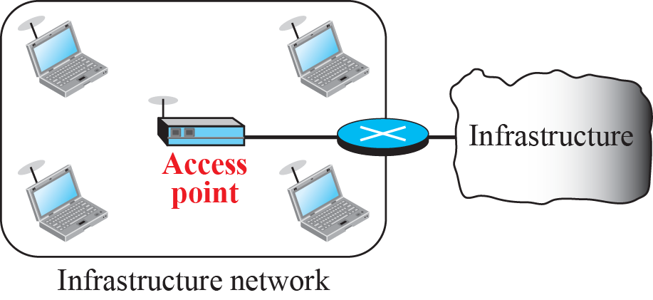
Figure 15.2: Connection of a wired LAN and a wireless LAN to other
networks
15.7
Notes:
15.#

Slide 8
15.15.2 Characteristics
There are several characteristics of wireless LANs that either do not apply to wired LANs or the existence of which is negligible and can be ignored. We discuss some of these characteristics here to pave the way for discussing wireless LAN protocols.
15.8
Notes:
15.#

Slide 9
15.15.3 Access Control
Maybe the most important issue we need to discuss in a wireless LAN is access control—how a wireless host can get access to the shared medium (air). The CSMA/CD algorithm does not work in wireless LANs for three reasons:
Wireless hosts do not have enough power to send and receive at the same time.
The hidden station problem prevents collision detection
The distance between stations can be great.
15.9
Notes:
15.#

Slide 10
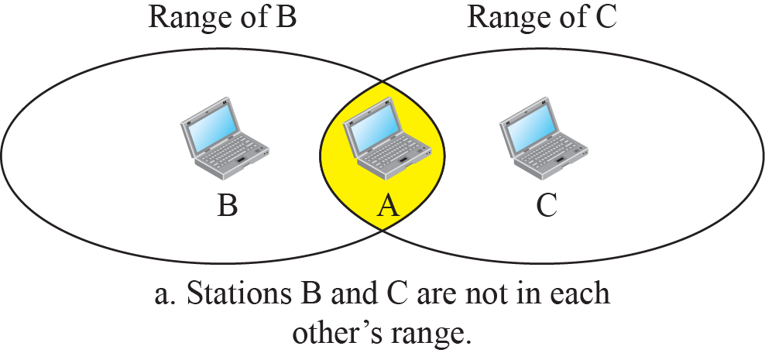
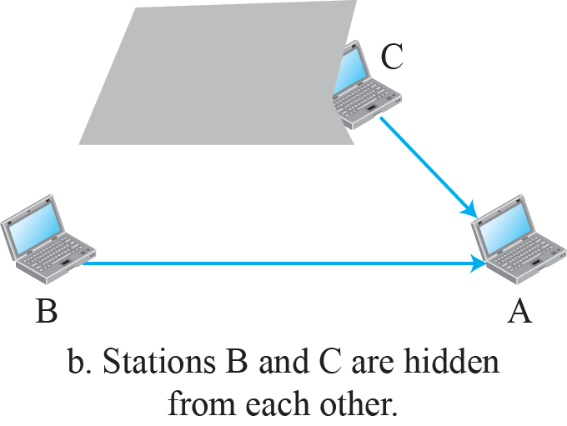
Figure 15.3: Hidden station problem
15.10
Notes:
15.#

Slide 11
15-2 IEEE 802.11 PROJECT
IEEE has defined the specifications for a wireless LAN, called IEEE 802.11, which
covers the physical and data-link layers. It is sometimes called wireless Ethernet. In some countries, including the United States, the public uses the term WiFi (short for wireless fidelity) as a synonym for wireless LAN. WiFi, however, is a wireless LAN that is certified by the WiFi Alliance.
15.11
Notes:
15.#

Slide 12
15.2.1 Architecture
The standard defines two kinds of services: the basic service set (BSS) and the extended service set (ESS).
15.12
Notes:
15.#

Slide 13
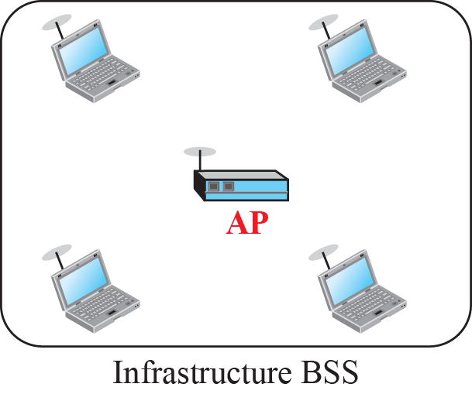
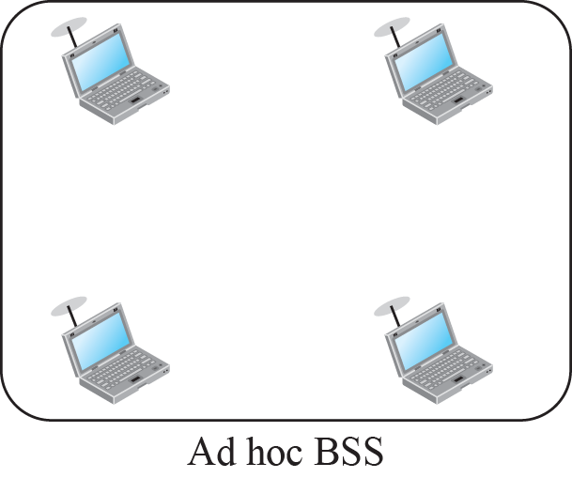
Figure 15.4: Basic service sets (BSSs)
15.13
Notes:
15.#

Slide 14
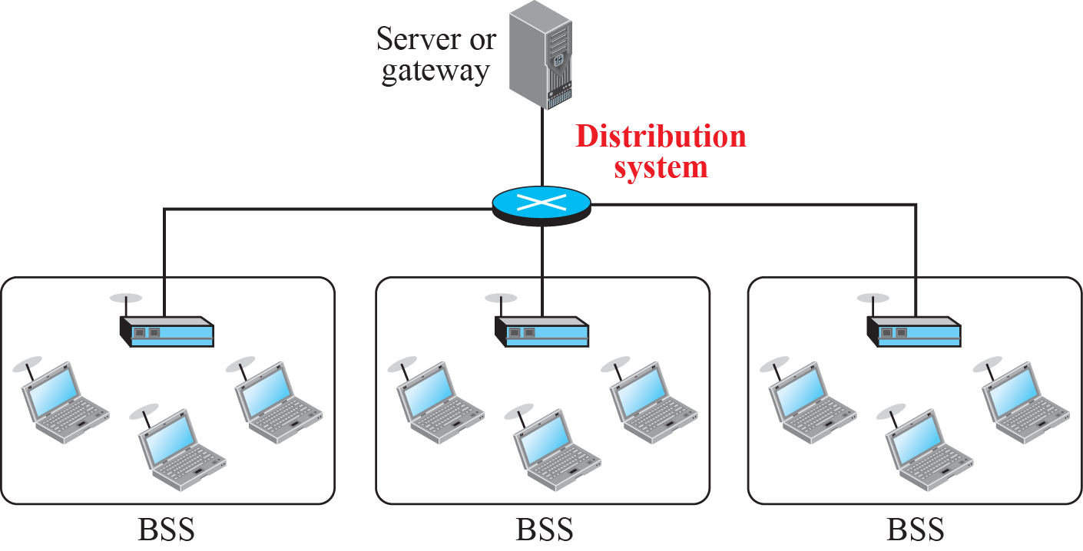
Figure 15.6: Extended service set (ESS)
15.14
Notes:
15.#

Slide 15
15.2.2 MAC Sublayer
IEEE 802.11 defines two MAC sublayers: the distributed coordination function (DCF) and point coordination function (PCF). Figure 15.6 shows the relationship between the two MAC sublayers, the LLC sublayer, and the physical layer. We discuss the physical layer implementations later in the chapter and will now concentrate on the MAC sublayer.
15.15
Notes:
15.#

Slide 16
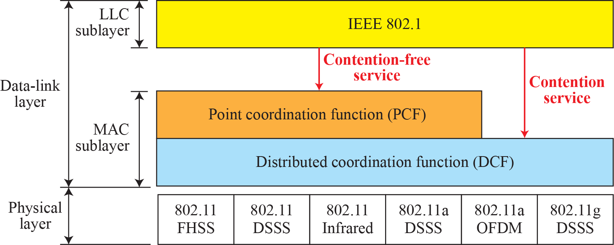
Figure 15.6: MAC layers in IEEE 802.11 standard
15.16
Notes:
15.#

Slide 17

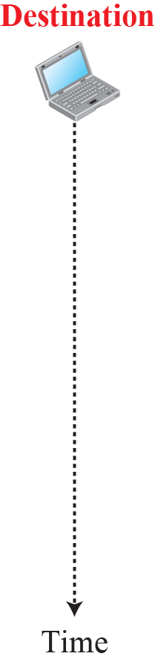











Figure 15.7: CSMA/CA and NAV
Distributed Interface state
Small Interface
state
It also take how
Much time it take
To send data
Clear to send
Network allocation
vector
15.17
Notes:
15.#

Slide 18
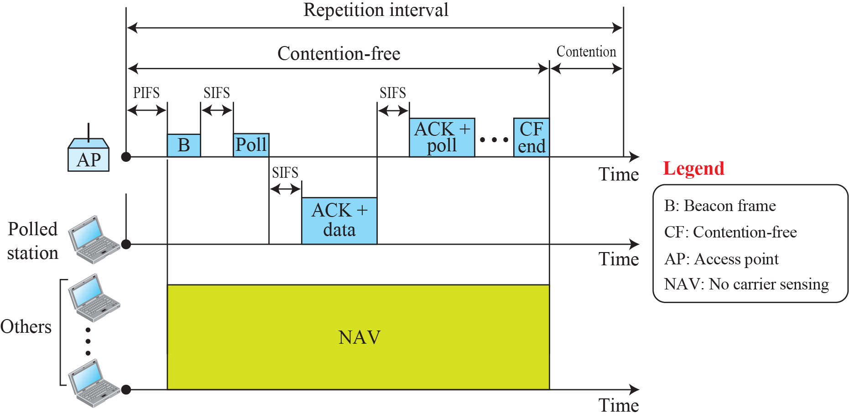
Figure 15.8: Example of repetition interval
wait
wait
Poll for anyone
want to send
Send the
data
It send Ack to poll I
am done
15.18
Notes:
15.#

Slide 19

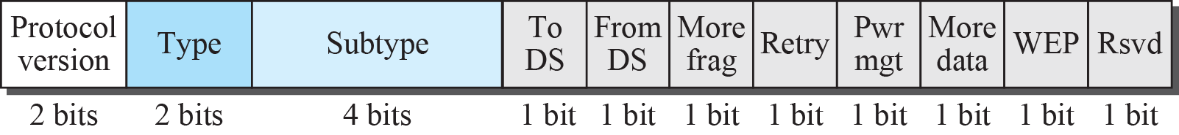
Figure 15.9: Frame format
15.19
Notes:
15.#

Slide 20
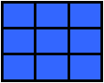
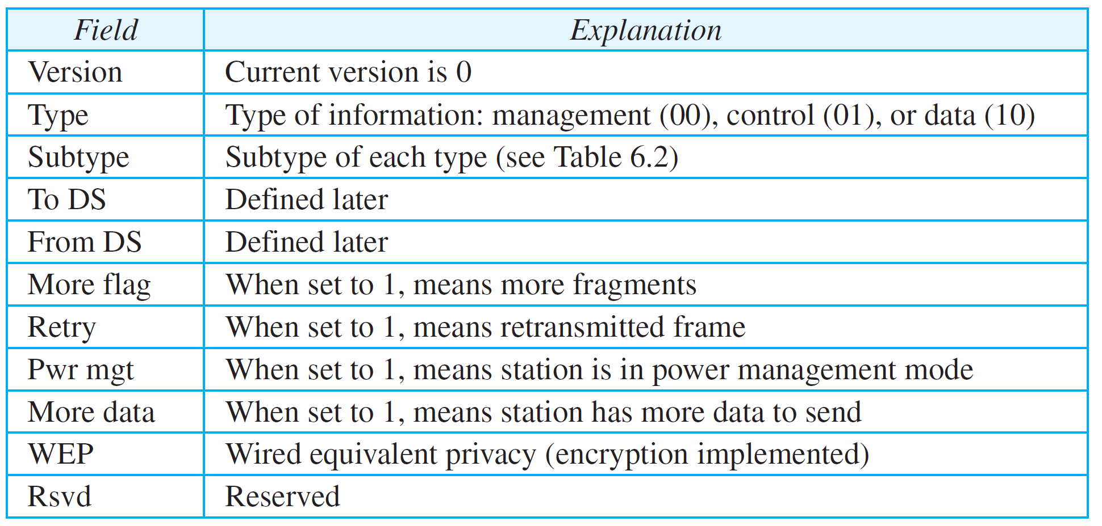
Table 15.1: Subfields in FC field
15.20
Notes:
20

Slide 21
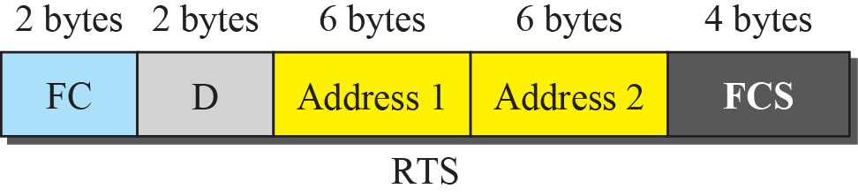
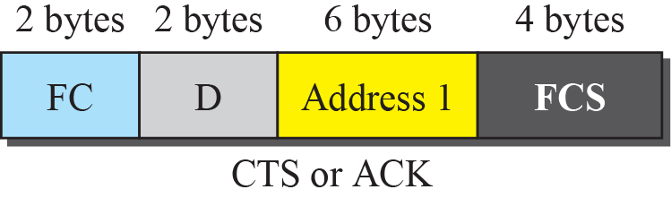
Figure 15.10: Control frames
15.21
Notes:
15.#

Slide 22
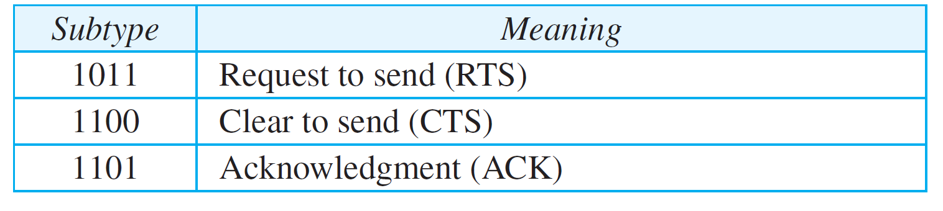
Table 15.2: Values of subfields in control frames
15.22
Notes:
22

Slide 23
15.2.3 Addressing Mechanism
The IEEE 802.11 addressing mechanism specifies four cases, defined by the value of the two flags in the FC field, To DS and From DS. Each flag can be either 0 or 1, resulting in four different situations. The interpretation of the four addresses (address 1 to address 4) in the MAC frame depends on the value of these flags, as shown in Table 15.3.
15.23
Notes:
15.#

Slide 24
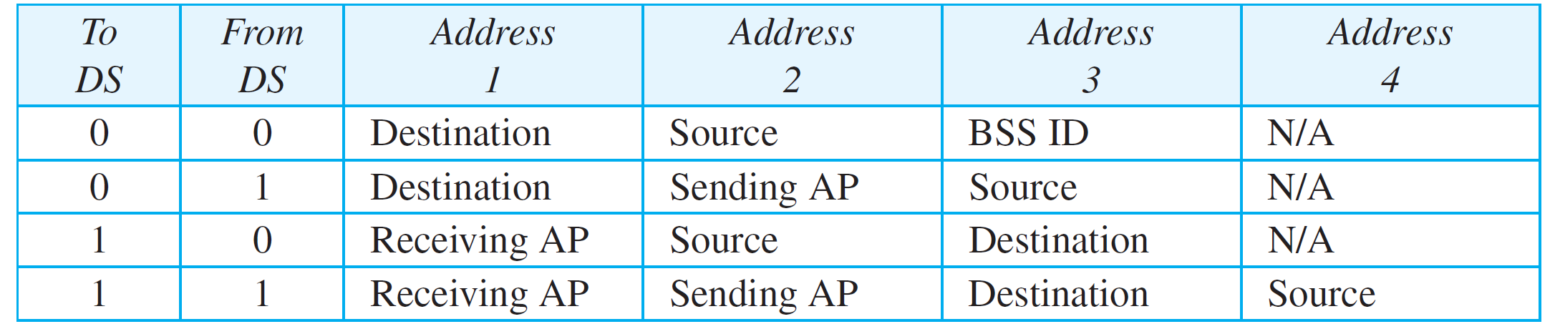
Table 15.3: Addresses
15.24
Notes:
24

Slide 25
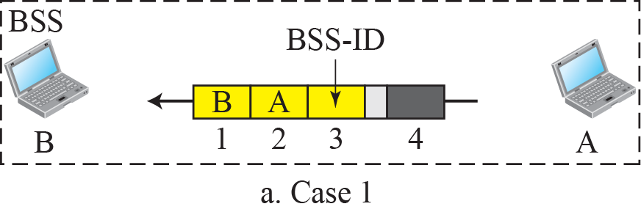
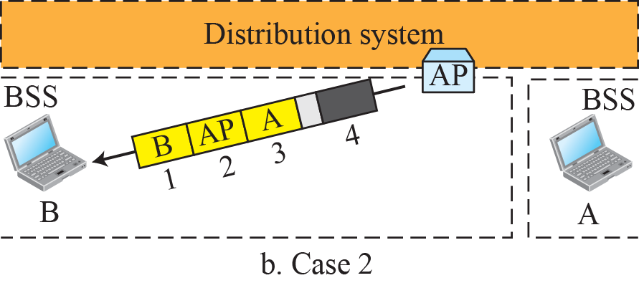
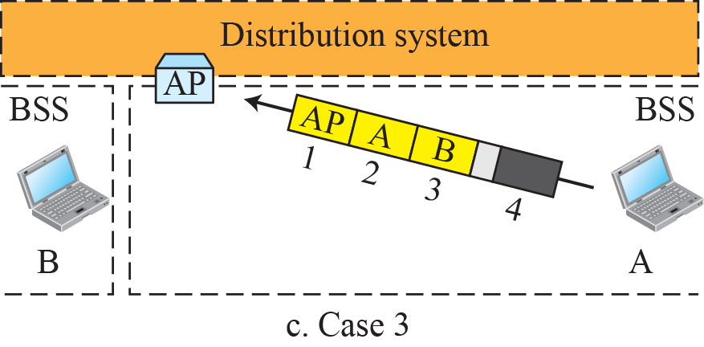
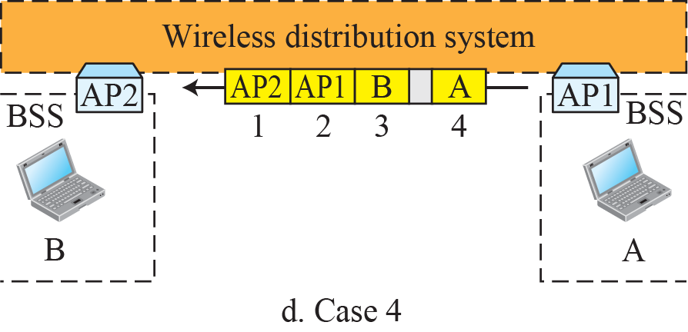
Figure 15.11: Addressing mechanisms
15.25
Notes:
15.#

Slide 26
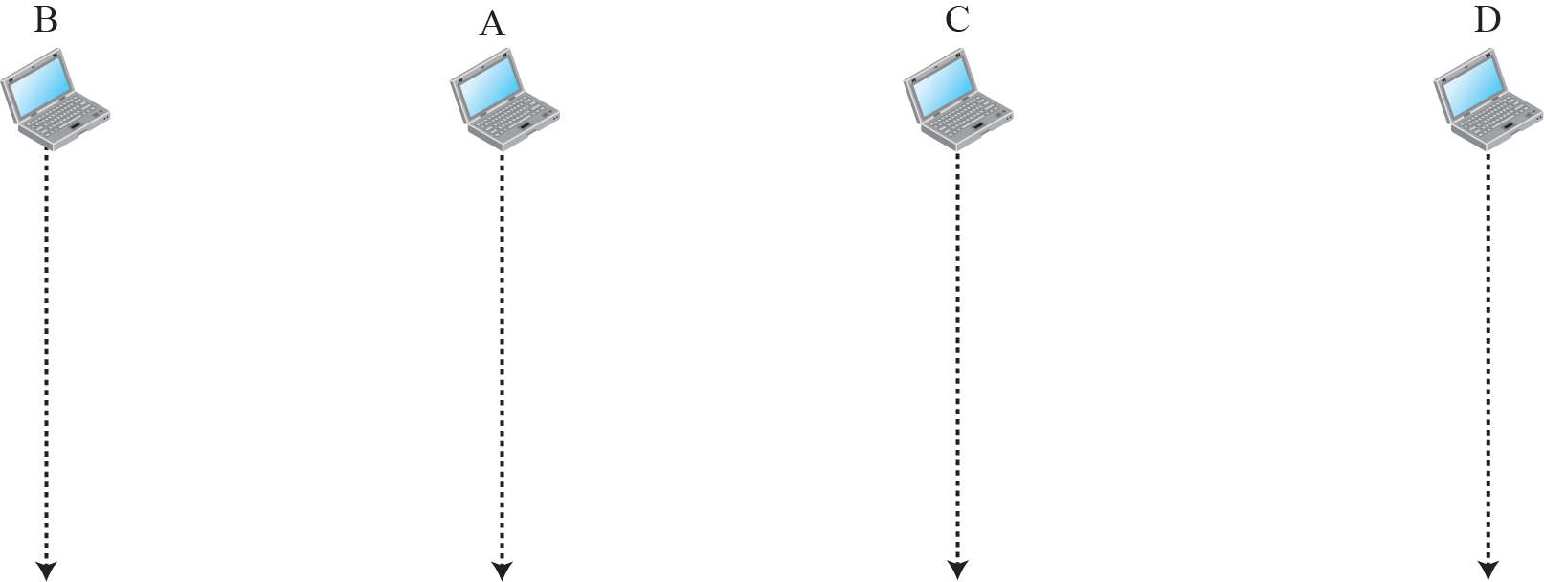
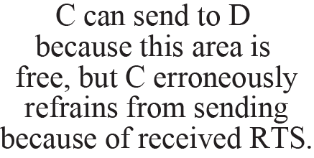


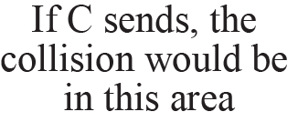
Figure 15.12: Exposed station problem
15.26
Notes:
15.#

Slide 27
15.2.4 Physical Layer
We discuss six specifications, as shown in Table 15.4. All implementations, except the infrared, operate in the industrial, scientific, and medical (ISM) band, which defines three unlicensed bands in the three ranges 902–928 MHz, 2.400–4.835 GHz, and 5.725–5.850 GHz.
15.27
Notes:
15.#

Slide 28
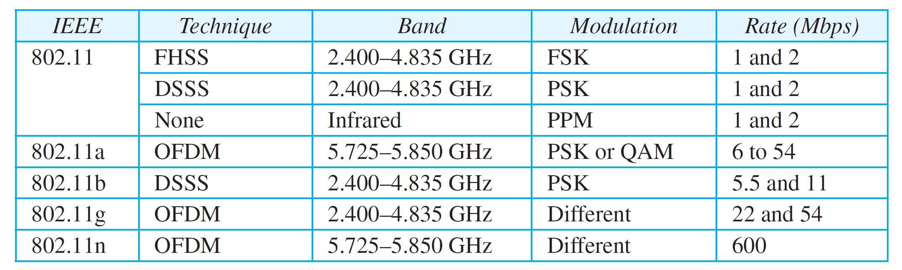
Table 15.4: Specifications
15.28
Notes:
28

Slide 29
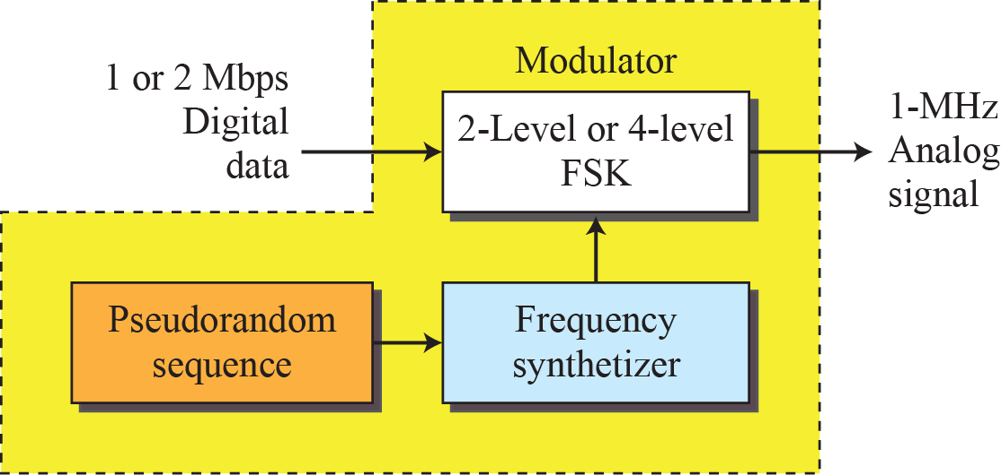
Figure 15.13: Physical layer of IEEE 802.11 FHSS
15.29
Notes:
15.#

Slide 30
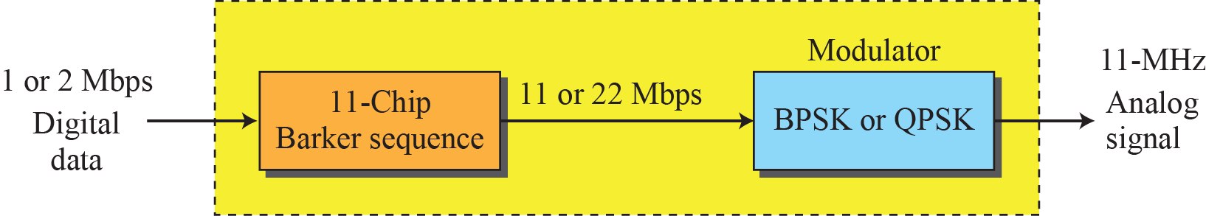
Figure 15.14: Physical layer of IEEE 802.11 DSSS
15.30
Notes:
15.#

Slide 31
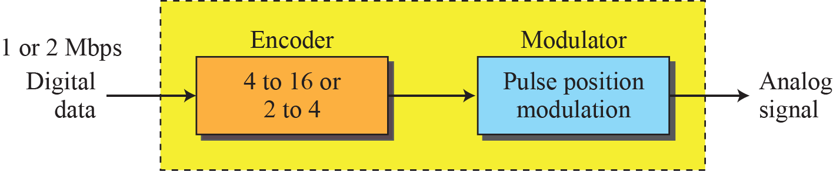
Figure 15.15: Physical layer of IEEE 802.11 infrared
15.31
Notes:
15.#

Slide 32
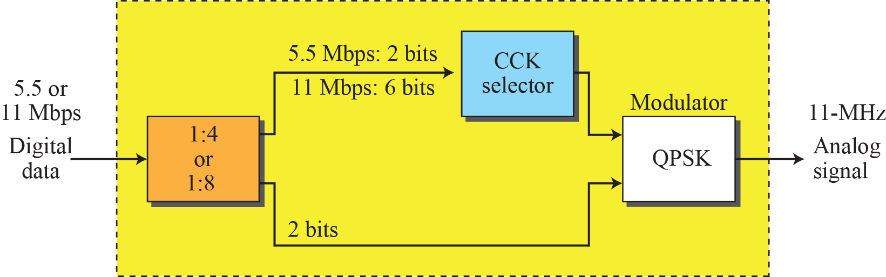
Figure 15.16: Physical layer of IEEE 802.11b
15.32
Notes:
15.#

Slide 33
15-3 BLUETOOTH
Bluetooth is a wireless LAN technology designed to connect devices of different functions when they are at a short distance from each other. A Bluetooth LAN is an ad hoc network. The devices, sometimes called gadgets, find each other and make a network called a piconet.
15.33
Notes:
15.#

Slide 34
15.3.1 Architecture
Bluetooth defines two types of networks: piconet and scatternet.
Pico-net=One device at a time connect only 8 device
15.34
Notes:
15.#

Slide 35
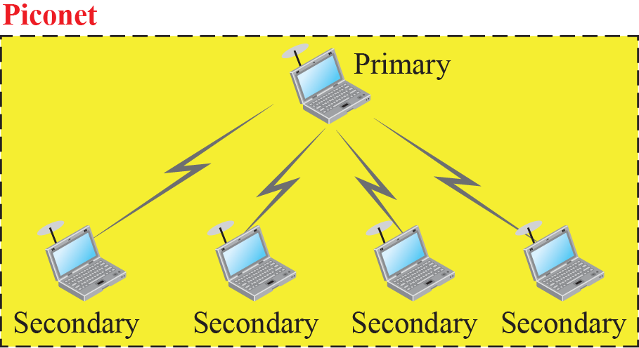
Figure 6.17: Piconet
15.35
Notes:
15.#

Slide 36
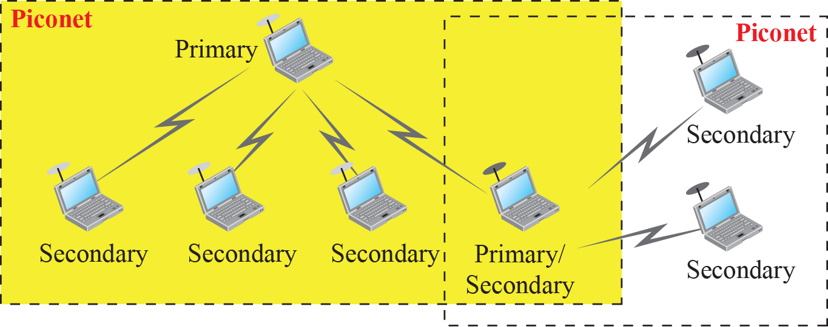
Figure 15.18: Scatternet
15.36
Notes:
15.#

Slide 37
15.3.2 Bluetooth Layers
Bluetooth uses several layers that do not exactly match those of the Internet model we have defined in this book. Figure 15.19 shows these layers.
15.37
Notes:
15.#

Slide 38
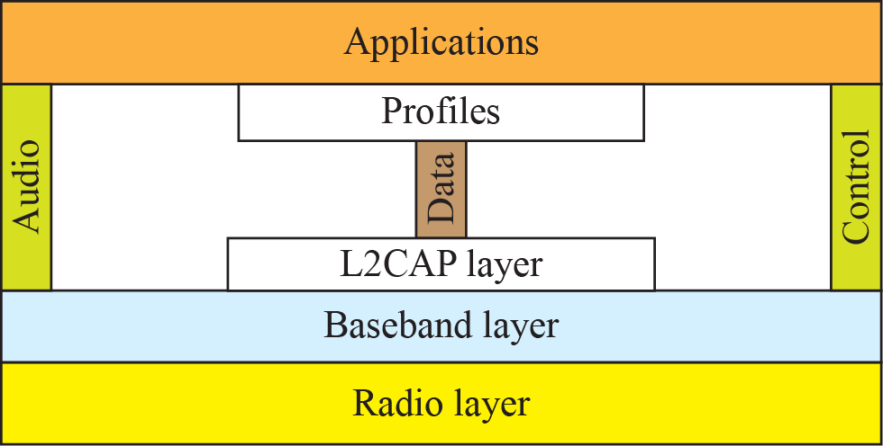
Figure 15.19: Bluetooth layers
Link layer
Actual Transmisson
15.38
Notes:
15.#

Slide 39
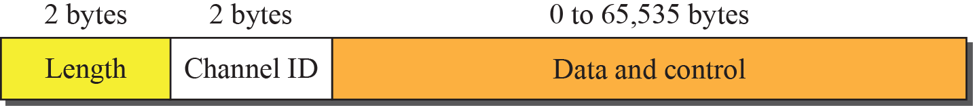
Figure 15.20: L2CAP data packet format
8 device [1+8]
Primary,secondary(they associate with id)
15.39
Notes:
15.#

Slide 40
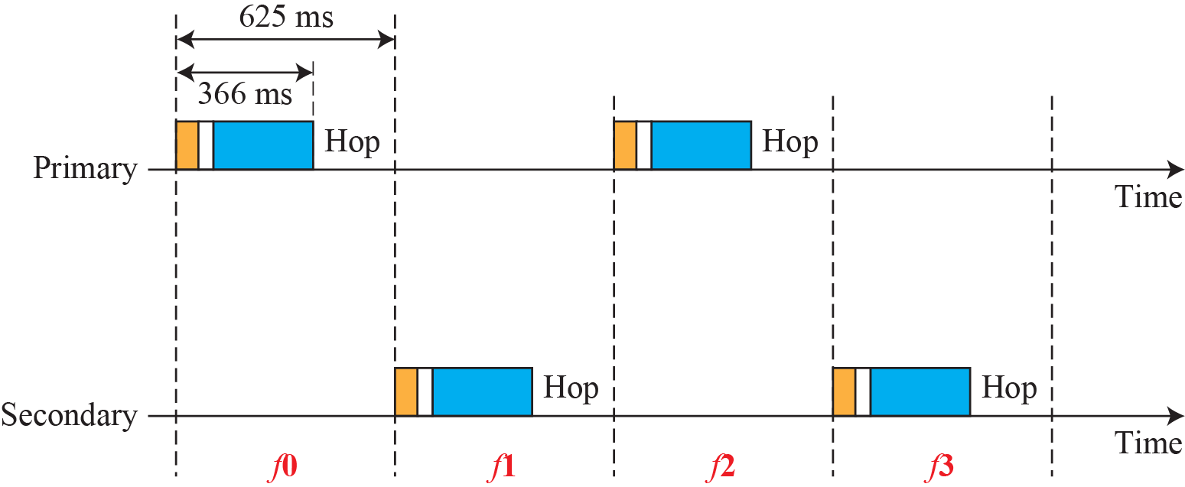


Figure 6.21: Single-secondary communication
15.40
Notes:
15.#

Slide 41
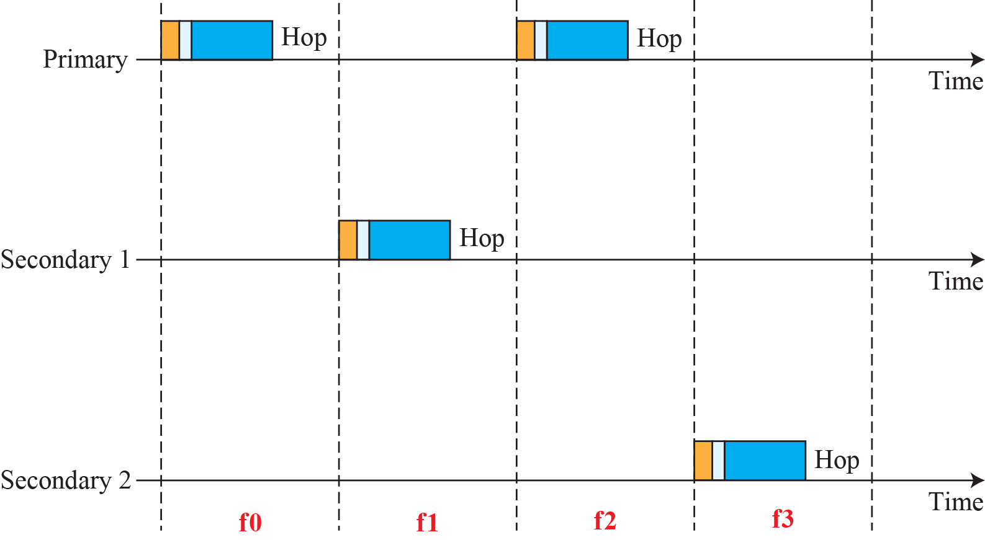

Figure 6.22: Multiple-secondary communication
15.41
Notes:
15.#

Slide 42
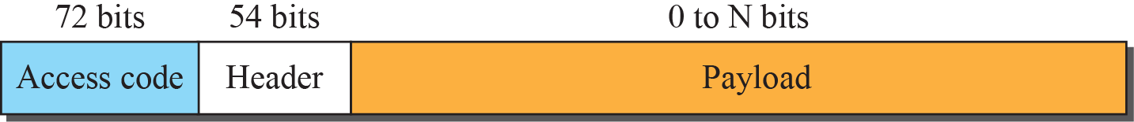
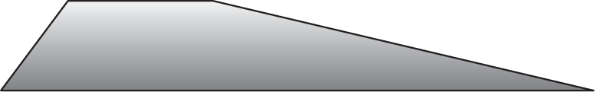
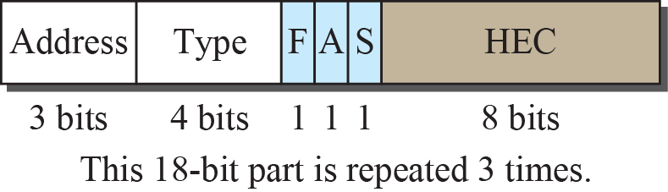
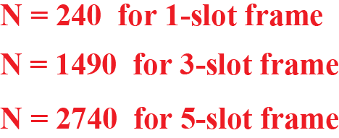
Figure 6.23: Frame format types
15.42
Notes:
15.#

